Slide 1




NEXT GEN EMPLOYABILITY PROGRAM
Creating a future-ready workforce
Team Members
College Name
Student Name :VIBESHA V
Student ID :au960221243050
Arunachala college of Engineering for women

Slide 2

CAPSTONE PROJECT SHOWCASE
Project Title
Car Rental Application using Django Framework
Abstract | Problem Statement | Project Overview | Proposed Solution | Technology Used | Modelling & Results | Conclusion

Slide 3
Abstract
The Car Rental Application built on the Django framework aims to provide an efficient and user-friendly platform for managing car rentals. This web-based application facilitates seamless interaction between car rental agencies and customers, offering a range of features for renting, returning, and managing rental cars.
The application's core functionality includes user authentication, enabling customers to register and log in securely. Upon authentication, customers can browse through available cars, view details such as make, model, year, and availability, and initiate rental requests.
For car rental agencies, the application provides administrative tools to manage the fleet of available cars. Agency personnel can add new cars to the inventory, update car information, mark cars as available or rented, and track rental transactions.The application employs Django's Model-View-Template (MVT) architecture, utilizing Django models to represent car data and rental transactions. Views handle user requests, rendering appropriate templates to display information and gather user input. The application also implements forms for user registration, rental requests, and administrative tasks.
Source :

Slide 4
Problem Statement
The existing car rental process is marred by paperwork, limited visibility of available cars, and inefficient communication between agencies and customers. This results in delays, opacity in car availability, and inconvenience. To address these issues, a modernized car rental system is necessary. This project aims to develop a Car Rental Application using Django framework, providing a user-friendly platform for renting and managing cars. Key features include user authentication, car browsing, rental request submission, and administrative tools for inventory management. By implementing these features, the application seeks to streamline the rental process, improve transparency in car availability, and enhance communication between agencies and customers. Utilizing Django's Model-View-Template architecture and forms for input validation, along with deployment to hosting platforms, the application aims to revolutionize the car rental industry, offering a modern, efficient, and user-centric rental experience.
Source :

Slide 5
Project Overview
The Car Rental Application is a comprehensive platform designed to streamline the car rental process, foster transparency in car availability, and improve communication between rental agencies and customers. It encompasses several key features, including user authentication to ensure secure registration and login for both customers and rental agency personnel. Through a user-friendly interface, customers can browse available cars, view detailed information such as make, model, year, and availability status, and seamlessly submit rental requests indicating their desired duration and any additional requirements. On the administrative side, rental agencies have access to tools for efficiently managing their inventory, enabling tasks such as adding new cars, updating information, and marking cars as available or rented. The application also facilitates communication channels between agencies and customers, allowing for timely updates, responses to inquiries, and coordination of rental logistics. By integrating with Django's built-in admin panel for database management and deploying to hosting platforms for accessibility, the Car Rental Application aims to revolutionize the car rental industry, providing a modern, efficient, and user-centric rental experience for all stakeholders involved.
Source :

Slide 6
Proposed Solution
The proposed solution for the Car Rental Application entails the development of a comprehensive platform using the Django framework. This solution will address the inefficiencies present in traditional car rental processes by offering a user-friendly web interface accessible across devices. Key features of the solution include a secure user authentication system to facilitate registration and login for customers and rental agency personnel. The application will provide robust inventory management tools, allowing rental agencies to efficiently add, update, and manage car listings, including details like make, model, year, availability status, and pricing. Customers will benefit from a streamlined rental request process, enabling them to browse available cars, submit rental requests, and specify rental durations and additional requirements. Additionally, the solution will incorporate communication features to facilitate interactions between agencies and customers, ensuring timely updates on rental status and facilitating inquiries. Integration with Django's admin panel will simplify database management, while deployment to hosting platforms will ensure accessibility and scalability. Overall, the proposed solution aims to revolutionize the car rental experience, enhancing transparency, efficiency, and user satisfaction in the industry.
Source :

Slide 7


Technology Used
Front-end
Back-end
Source :

Slide 8
Modelling & Results
In modelling the Car Rental Application, Django models are employed to represent essential entities such as cars and rental transactions. The Car model encapsulates details like make, model, year, and availability status, while the Rental model links rented cars to customers and records pertinent rental dates. Through views and templates, users interact seamlessly with the application, browsing available cars, submitting rental requests, and managing rental transactions. Expected outcomes include a user-friendly interface facilitating effortless navigation and rental request submission, efficient inventory management tools empowering rental agencies to oversee their fleet, and timely communication channels ensuring customers receive updates on their rental status promptly. By maintaining accurate rental records and providing insights into rental trends, the application aims to streamline operations, enhance transparency, and foster improved communication between agencies and customers. Through user testing and performance metrics analysis, the application's efficacy in optimizing the car rental process can be assessed, enabling iterative enhancements to meet the evolving needs of stakeholders and ensuring a modern, efficient, and user-centric rental experience.
Source :

Slide 9
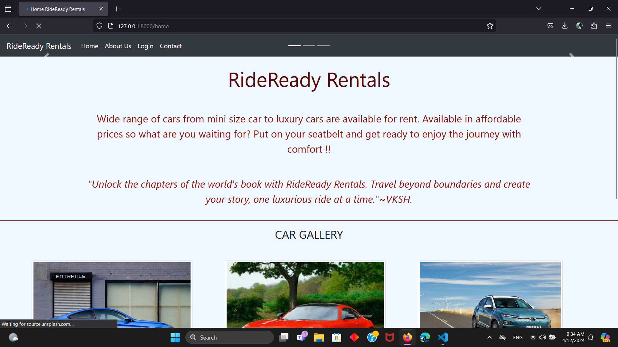
Homepage

Slide 10
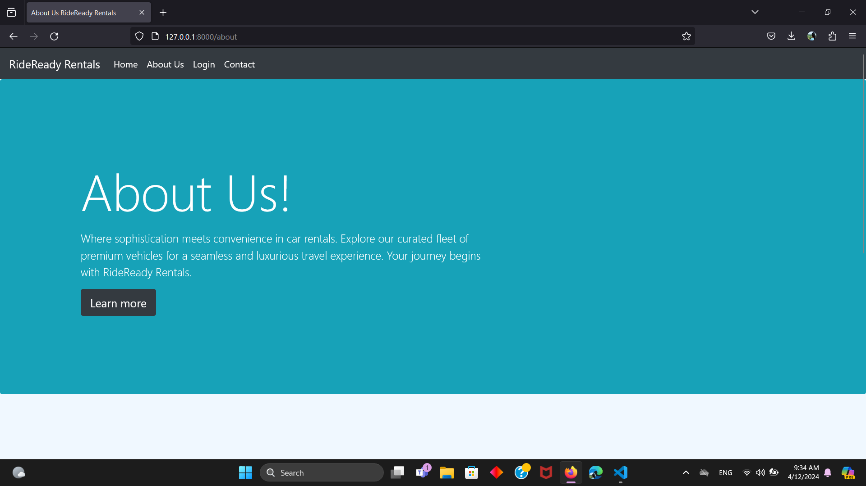
About-Us-Page

Slide 11
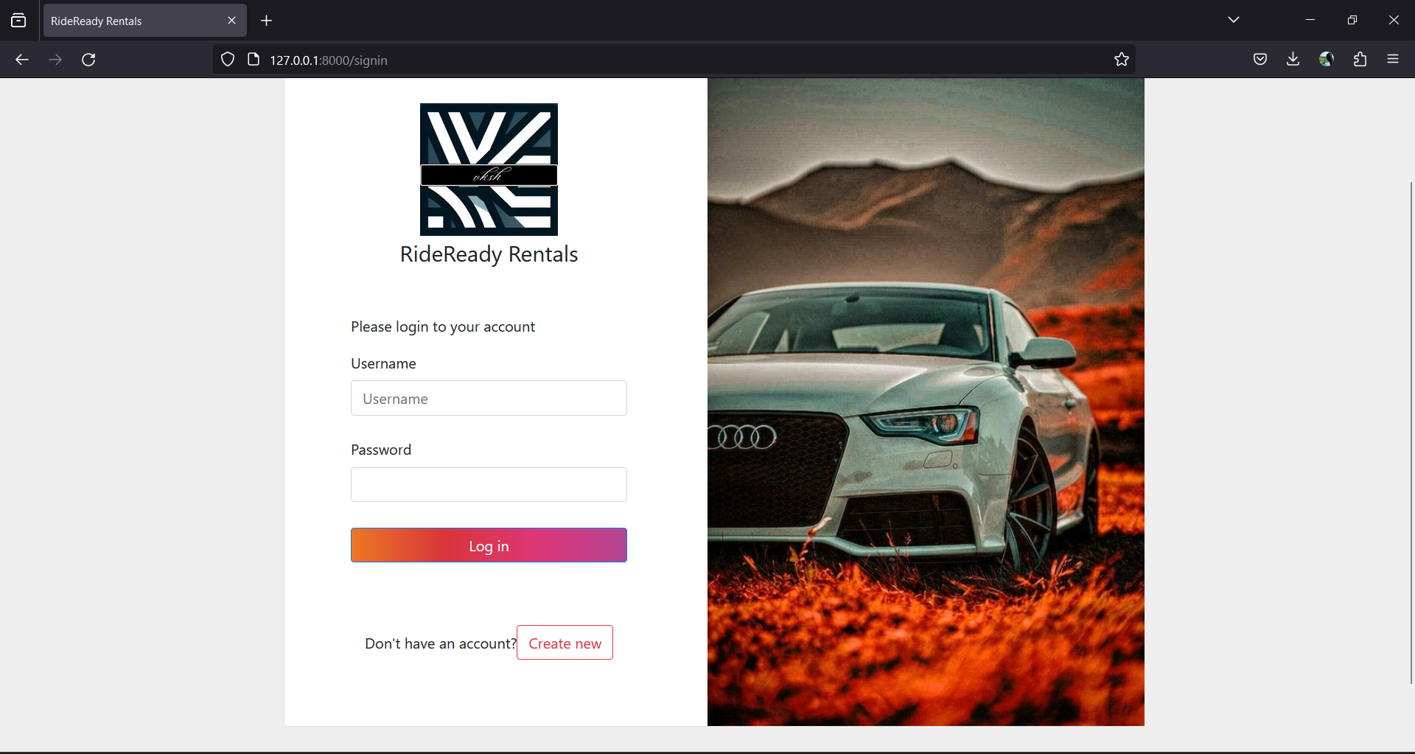
Login-Page

Slide 12
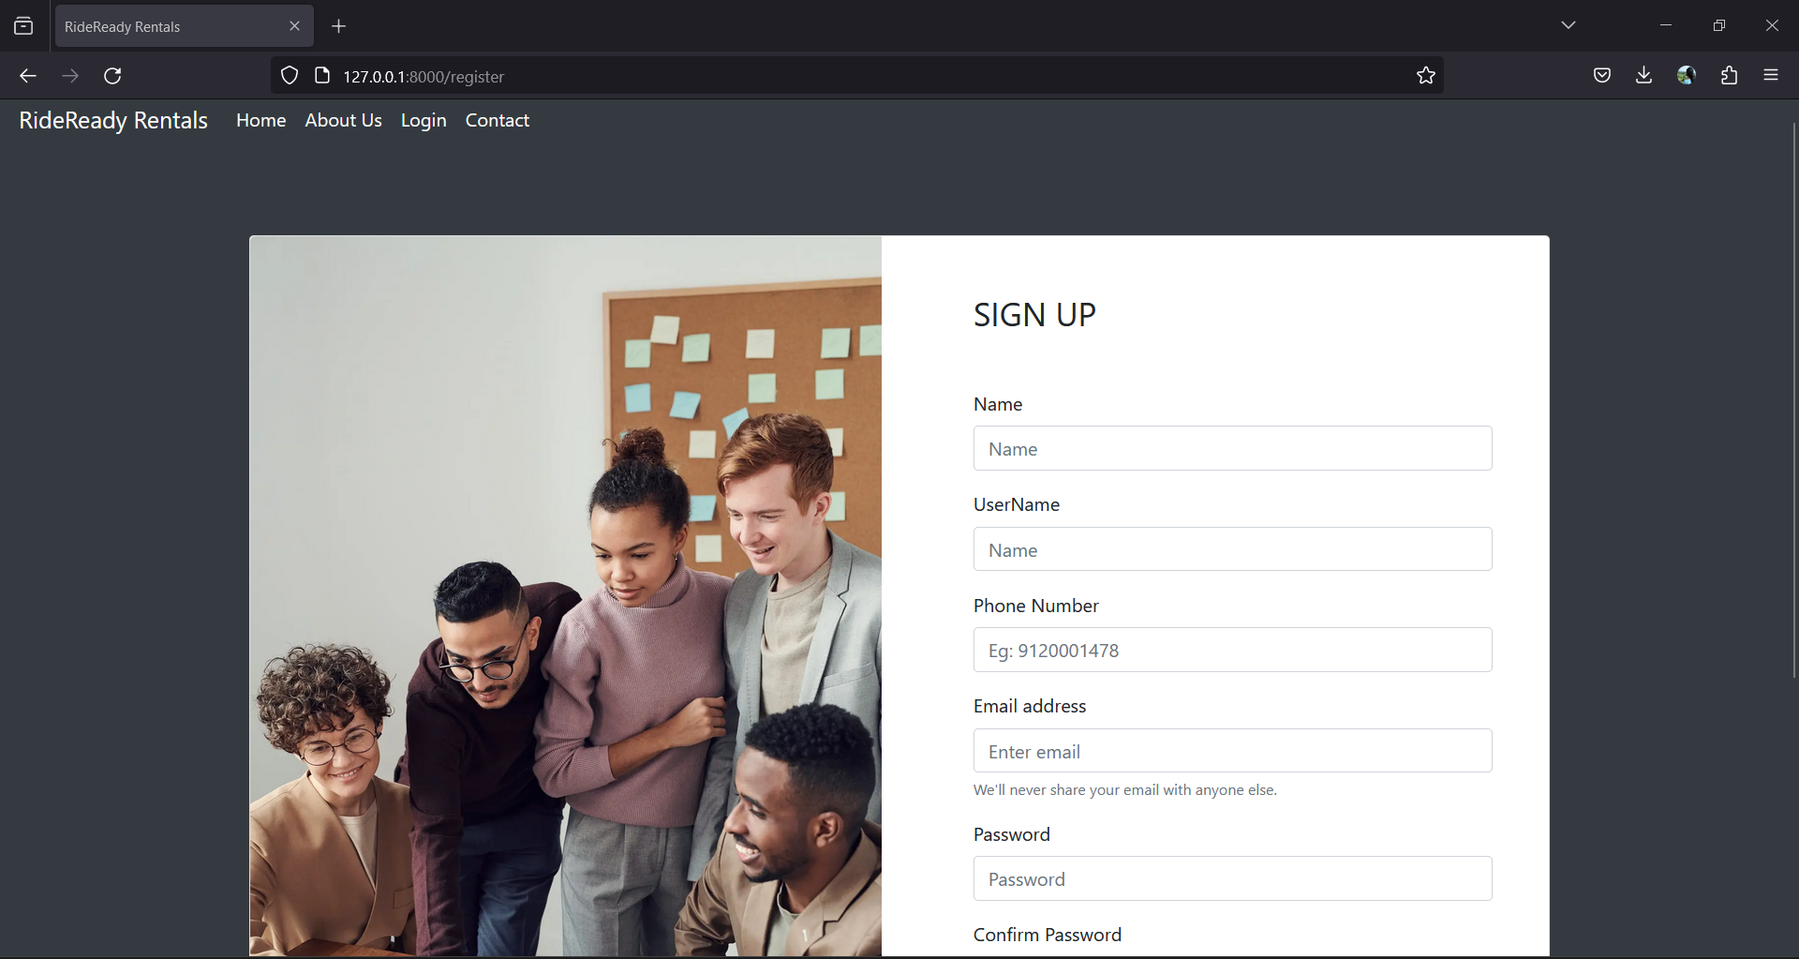
Register-Page

Slide 13
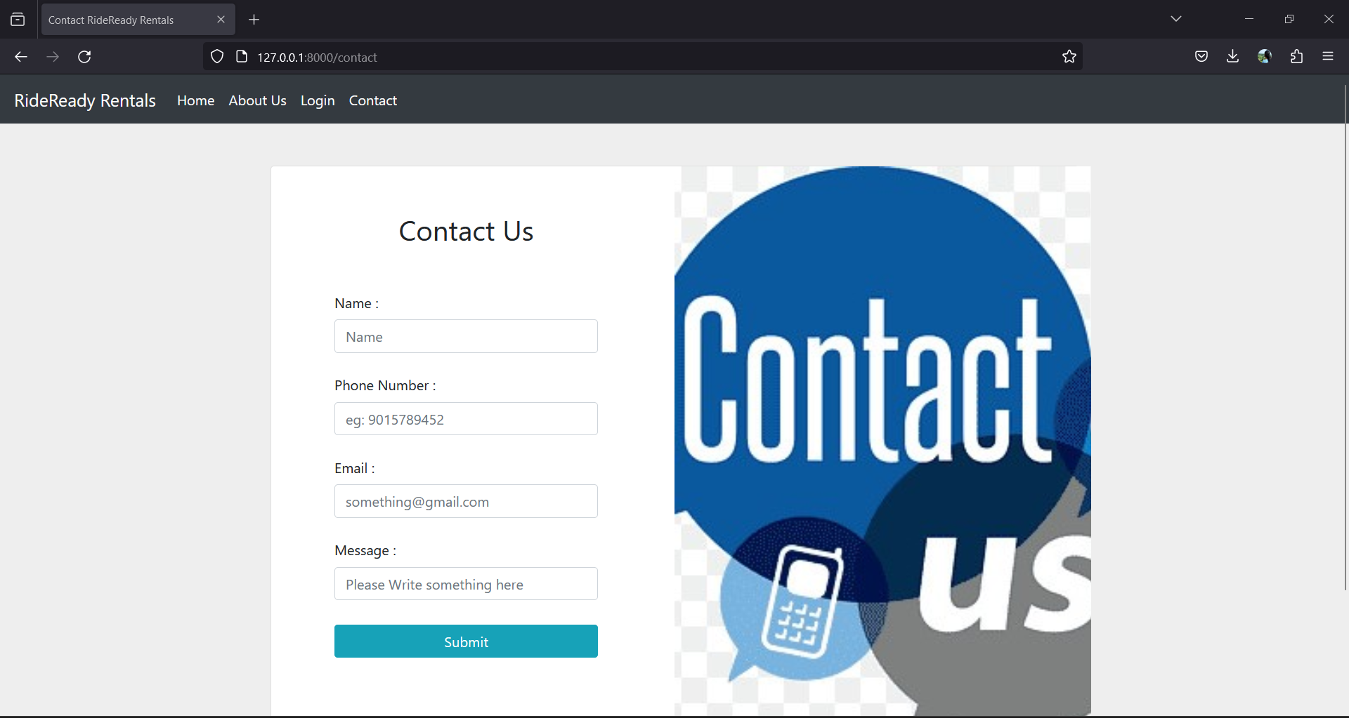
Contact us

Slide 14
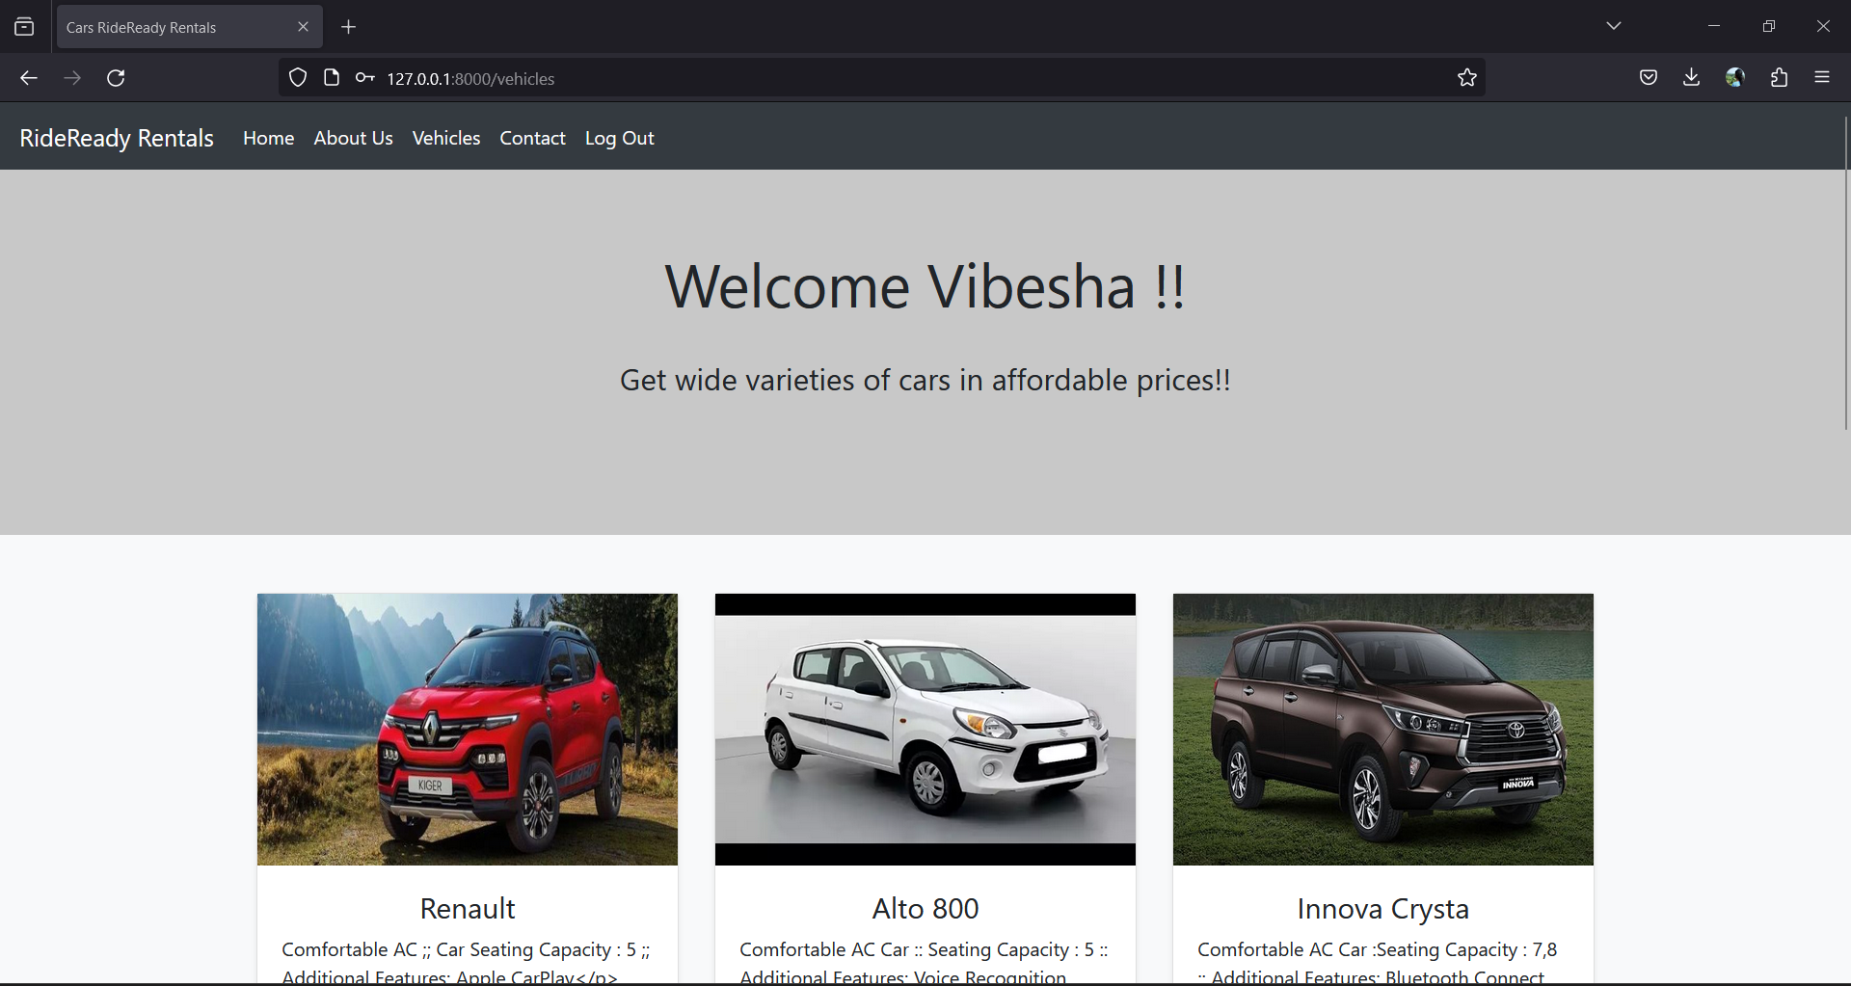
Vehicles

Slide 15
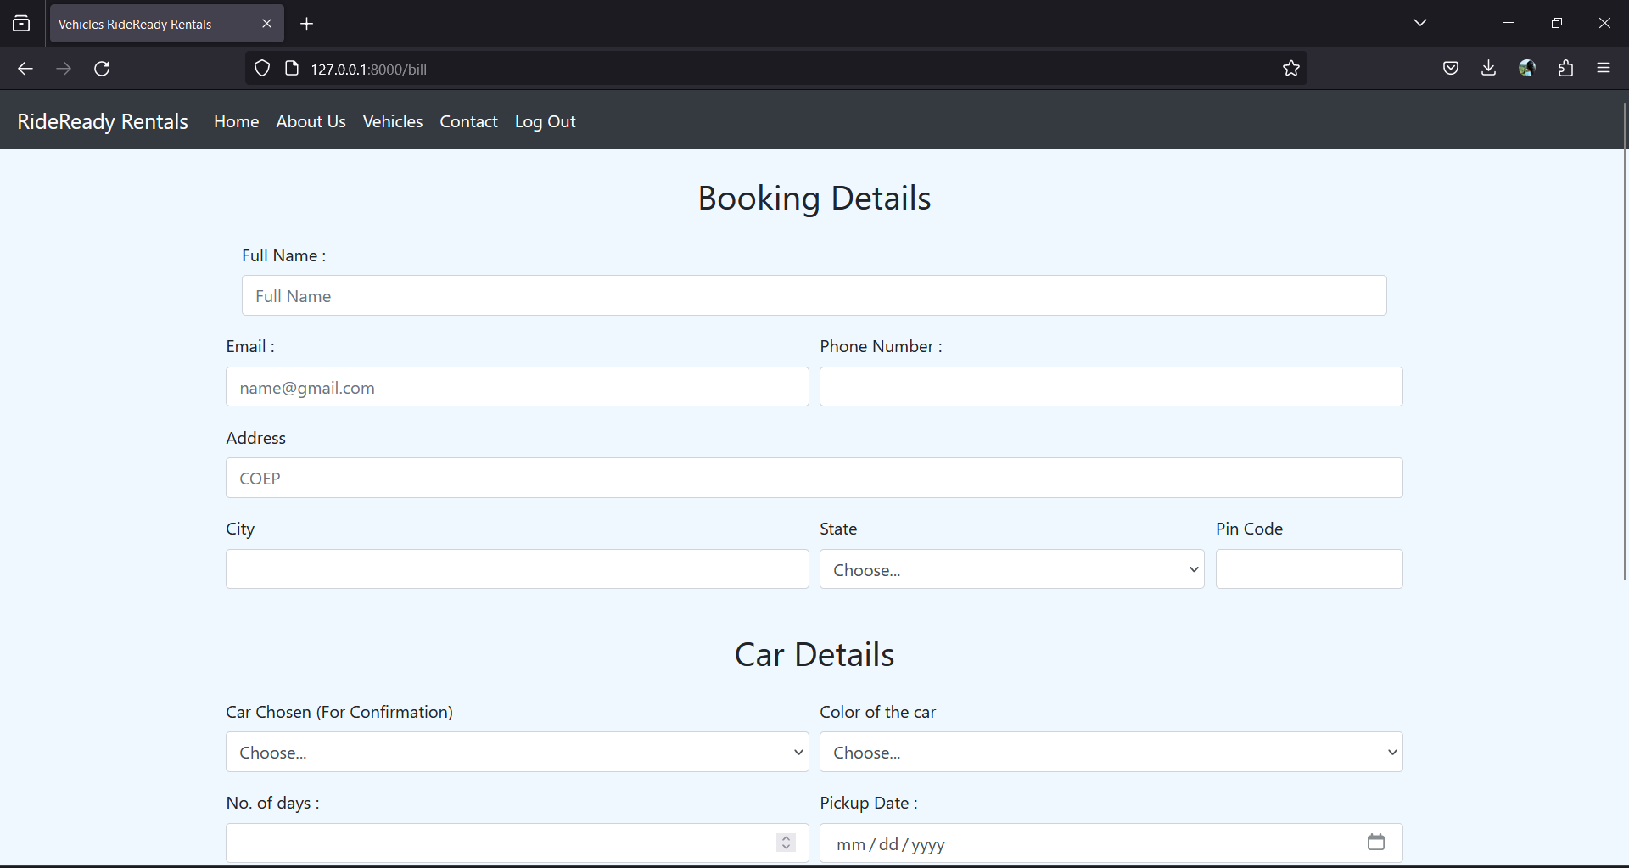
Booking

Slide 16
Future Enhancements:
In the future, the Car Rental Application can be enhanced in various ways to elevate user experience and operational efficiency. Integrating secure payment gateways would streamline transactions, while advanced search and filtering options could refine car browsing. Developing a mobile application version would extend accessibility, and incorporating geolocation and mapping features would enhance navigation and convenience. Implementing a rating and review system could gather feedback, while vehicle tracking technology could optimize fleet management. Predictive analytics algorithms could forecast demand, and integration with external platforms could offer bundled services. Multi-language support would cater to diverse users, and social media integration could foster community engagement and marketing. By embracing these enhancements, the Car Rental Application would stay ahead of industry trends, ensuring continued growth, customer satisfaction, and competitiveness.

Slide 17
Conclusion
In conclusion, the Car Rental Application, built on the Django framework, stands as a robust solution poised to revolutionize the car rental industry. With its user-friendly interface, seamless functionality, and efficient management tools, the application offers a modern and convenient rental experience for both agencies and customers. By leveraging future enhancements such as payment integration, advanced search options, mobile application development, and predictive analytics, the application is positioned to adapt to evolving user needs and industry trends. As a result, it will continue to streamline operations, enhance transparency, and foster improved communication, ultimately setting new standards for efficiency and customer satisfaction in the car rental market. Through ongoing innovation and responsiveness to user feedback, the Car Rental Application remains committed to delivering a superior rental experience, driving sustained growth and success in the dynamic landscape of the car rental industry.
Source :

Slide 18
Thank You!
Notes:
Thank You !!

